Slide 1
Plans for statGPT
St. Jude KIDS24 Biohackathon
Stan Pounds
August 28, 2024

Slide 2

Statistical reporting requires a lot of (redundant) writing.
It would be nice if statistical analysis reports were automatically written and based on our own data.
statGPT
Quickly generates clearly written narratives based on an abstraction of the entire internet.
Quickly generates clearly written reports of statistical analyses of our scientific data.

Slide 3
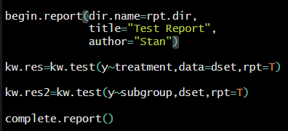
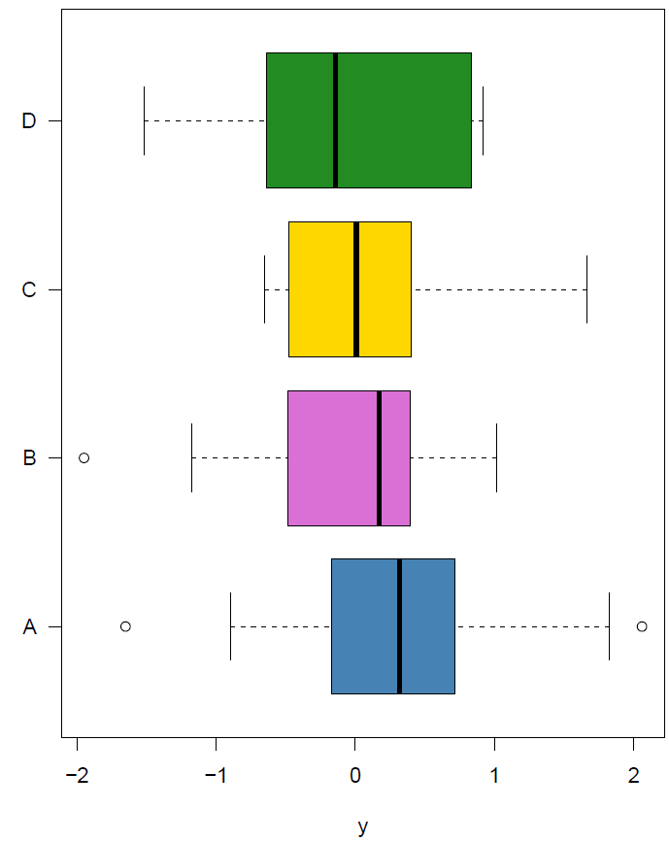
begin.report
Initializes a background memory environment
Creates the result folder and subfolders
kw.test
Performs the Kruskal-Wallis test
Generates and indexes figures and tables
Saves results in background and result folder
Association of y with treatment
The median of y was 0.320413 among the 12 treatment group A observations, 0.169026 among the 11 treatment group B observations, 0.006944 among the 14 treatment group C observations and -0.142896 among the 10 treatment group D observations with available data (p = 0.742). Table 1 provides summary statistics of y by treatment. Figure 1 provides box plots of y by treatment. This result ignores 1 observation with missing data.
complete.report
Extracts information from the background and folder
Generates narrative report file
Saves technical details, archives data sets, etc
Methods
The Kruskal-Wallis test [1] was used to compare the median of y across the treatment groups and compare the median of y across the subgroup groups.
Works Cited
[1] Kruskal WH, Wallis WA (1952). "Use of ranks in one-criterion variance analysis". Journal of the American Statistical Association. 47 (260): 583–621. doi:10.1080/01621459.1952.1048344

Slide 4
statGPT
Abstraction of the entire internet.
Your data and analysis methods.
Source
LLM cannot provide sources.
Transparent with all refs, methods, & data
Traceability
Generative AI prone to hallucinate.
SJ Biostat templates filled in with user data.
Narrative
Every interaction saved on server.
Privacy
Everything is local.

Slide 5

statGPT
The user writes the narrative using the clunky `r ` syntax to insert quantitative results.
Narrative
The package writes the narrative and inserts quantitative results.
Figures
The user writes code to generate each figure in a code chunk.
The package generates the figures and automatically indexes them.
Tables
The user writes code to generate and insert each table.
The package generates the tables and inserts and indexes them.
References
The user creates a LaTeX bibliography and inserts citation commands.
The package cites references and creates the bibliography.
Documentation
The user must archive data sets and technical details.
The package archives data sets and technical details.

Slide 6
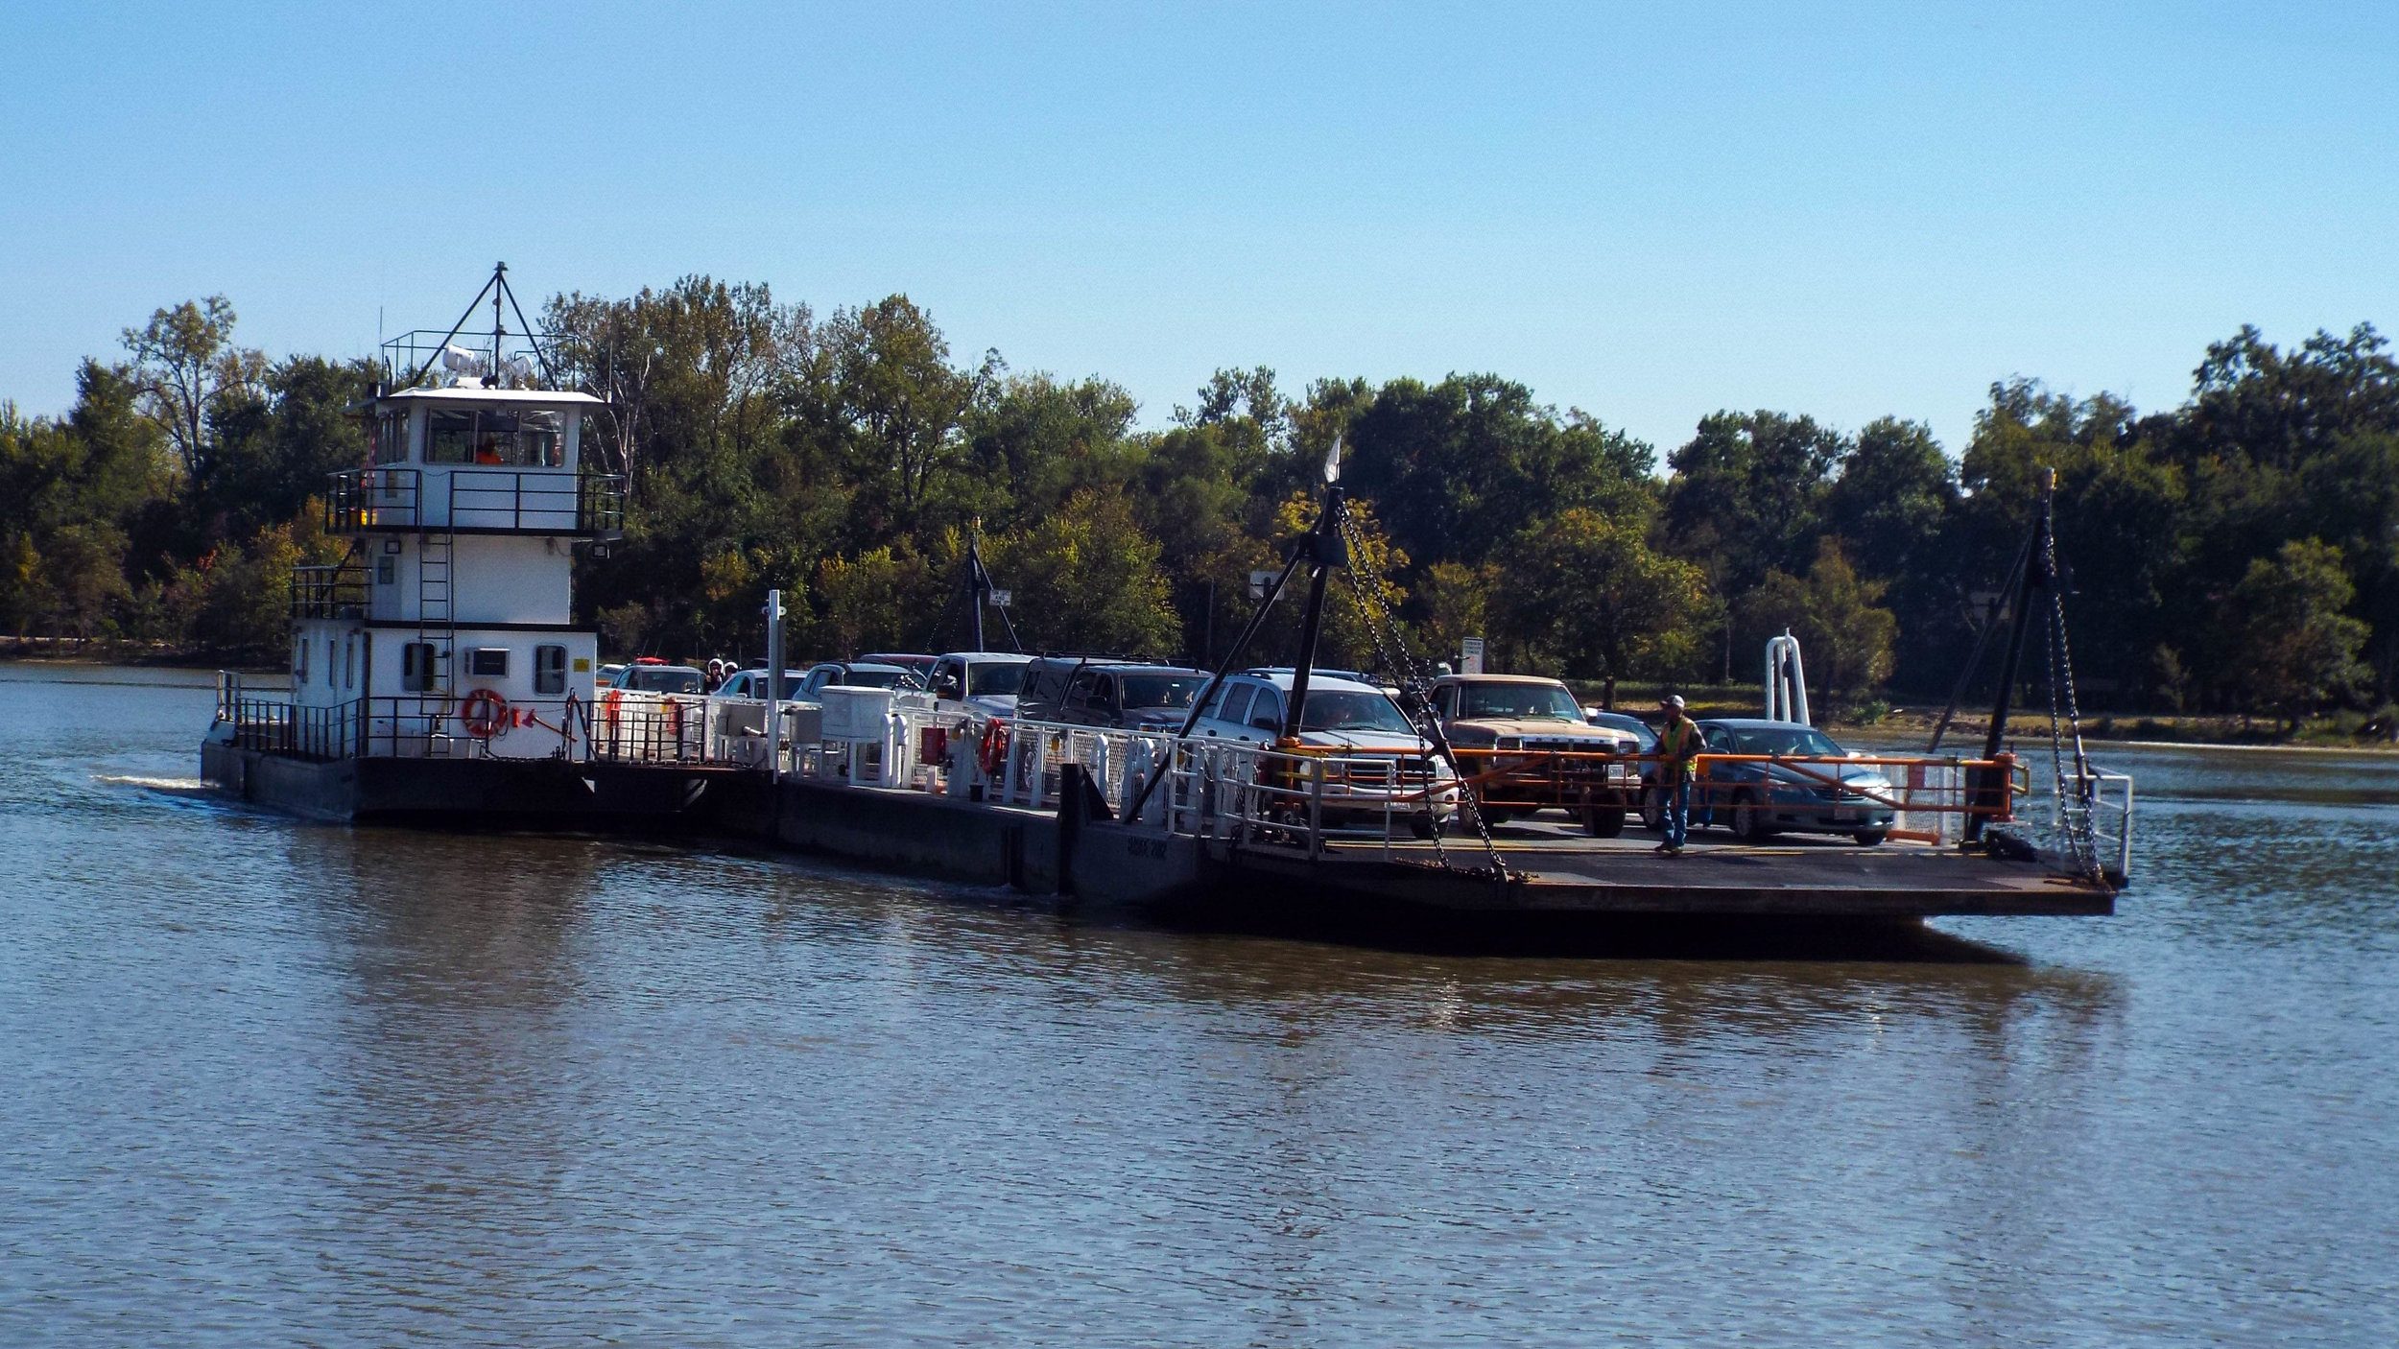

statGPT
The user does the analysis; the package writes the report.
The user does everything.
Getting It Done
It’s like crossing the river on a …

Slide 7
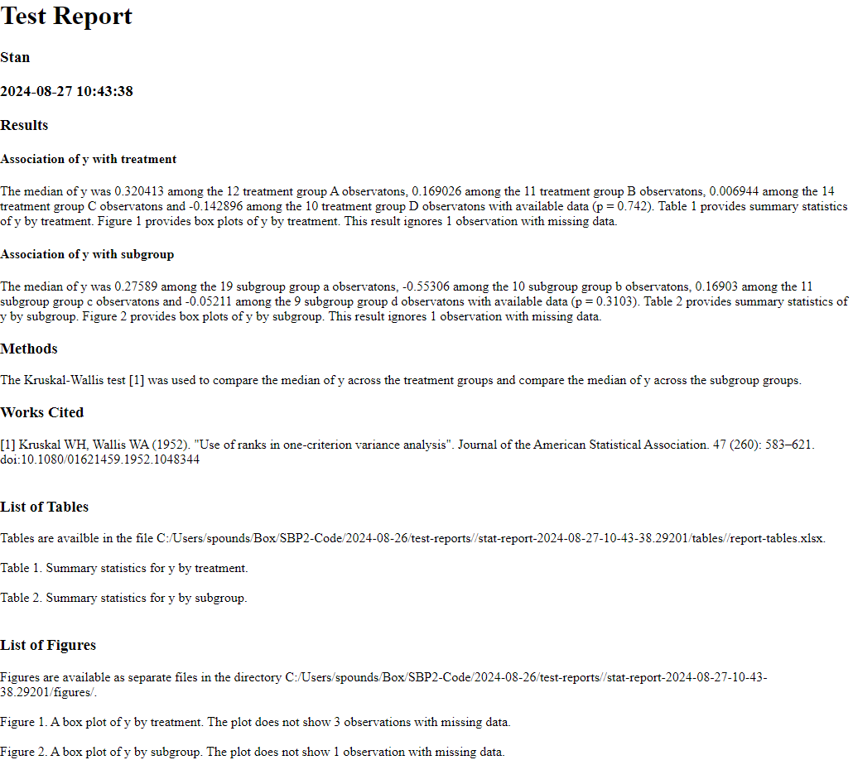






Streamlines Report Production
Archives Data & Technical Details
Code
Data
Figures
Tables
Technical
Narrative

Slide 8
kw-test.R
Performs KW test
Captioned boxplot
Table of descriptive stats
Generates narrative
Saves results in report
boxplot.R
Generates captioned boxplot Saves it in the report
summarize.R
Computes descriptive stats
Saves tables in the report
report.R
Defines begin.report
Defines complete.report
Defines functions to add/extract data to/from report memory environment
colors.R
Defines functions to “paint” data with consistent color schemes for all plots
Defines functions to define and select color palettes
base.R
Defines some useful low-level functions

Slide 9
kw.test
function(form, data, options)
form: formula or name of column(s) of data
data: a data.frame
options = default
alpha = 0.05: significance threshold
clr = “sbp.clrs”: name of color palette for figures
txt = 1: detail level for text (0:none, 1:some, 2+: more)
fig = 1: number of figures
tbl = 1: number of tables
mda = 1: missing data alert (0: none, 1: brief, 2: detailed)
dgt = 4: number of digits for numerical results in narrative
hdr = 4: HTML header tag level (1=HUGE, …, 6 = small)
rpt = F: include results in report?
rxv = 0: archiving (0: none, 1: yes but no big files, 2: all files)
fig.type = “pdf”: name of R figure function
… : options for R figure function
Intuitive argument syntax common for all high-level functions simplifies usage and expedites learning
Intuitive options common across high-level functions simplifies usage and expedites learning

Slide 10
kw.test
function(form, data, options)
##################################
# Get variable names
form.names=get.form.names(form,data)
y.name=form.names$y
grp.name=form.names$x[1]
##################################
# Compute summary statistics and KW test res.tbl=summarize(form,data,mda=mda) kw.res=kruskal.test(form,data)
##################################
# Produce boxplot if requested
if (fig>0)
{
bxpt=box.plot(form,data,clr=clr,
txt=txt,mda=mda,rpt=rpt,
fig.type=fig.type)
}
statGPT defined:
get.form.names
summarize
box.plot
Extracts names of y variable and group variable from form and confirms they are present in data
Note: common argument syntax
Performs the KW test and computes a table of summary stats
Note: common argument syntax
Generates and indexes the boxplot if requested by user
Note: common argument syntax

Slide 11
kw.test
function(form, data, options)
########################################
# Add table to report if requested by user
tbl.cap=NULL
if (tbl>0) tbl.cap=paste0("Summary statistics for ", y.name,
" by ",grp.name,". ")
if (rpt&&(tbl>0))
{
df.tbl=cbind.data.frame(stat=rownames(res.tbl),res.tbl)
colnames(df.tbl)[1]=y.name
report.table(df.tbl,tbl.cap)
}
##################################
# Prepare narrative text
res.txt=paste0("The median of ",y.name," was ",
txt.list(paste0(rpt.num(res.tbl["median",],dgt)," among the ",
res.tbl["available",]," ",grp.name," group ",
colnames(res.tbl)," observations")),
" with available data (p =
",rpt.num(kw.res$p.value,dgt),"). ")
statGPT defined:
report.table:
df.tbl: table as a data.frame
tbl.cap: table caption
txt.list
Vector of character strings to be a list like A, B, C, and D.

Slide 12
kw.test
function(form, data, options)
get.tbl.num
get.fig.num
Get current table & figure index
Generate narrative reference to table as requested (or not)
Generate narrative reference to figure as requested (or not)
################################
# add table and figure reference as requested
tbl.num=fig.num=1
if (rpt) { tbl.num=get.tbl.num()
fig.num=get.fig.num() }
if (tbl>0) res.txt=paste0(res.txt,paste0("Table ",tbl.num,
" provides summary statistics of ",
y.name," by ",grp.name,". "),collapse="")
if (fig>0) res.txt=paste0(res.txt,paste0("Figure ",fig.num,
" provides box plots of ",y.name,
" by ",grp.name,". "),collapse="")

Slide 13
kw.test
function(form, data, options)
Generate missing data alert as requested (or not)
Generate bibliographic reference for KW test
If report is requested, include it in the bibliography
####################################
# Add missing data alert
n.miss=sum(res.tbl["missing",])
if ((mda>0)&&(n.miss>0))
{ res.txt2=paste0("This result ignores ",n.miss,
" observation",c("","s")[1+(n.miss>1)]," with missing data. ")
res.txt=paste0(res.txt,res.txt2,collapse="") }
#########################################
# Bibliographic Reference
kw.ref='Kruskal WH, Wallis WA (1952). "Use of ranks in one-criterion variance analysis". Journal of the American Statistical Association. 47 (260): 583–621.' kw.id="doi:10.1080/01621459.1952.1048344"
bib.data=cbind.data.frame(id=kw.id,ref=kw.ref)
ref.num="[1]"
if (rpt) ref.num=cite.ref(kw.id,kw.ref)

Slide 14
kw.test
function(form, data, options)
Generate methods sentence (whether report is requested or not)
Honor user preferences indicated by options
############################################
# Methods sentence
ugrp=colnames(res.tbl)
mtd.txt=paste0("The Kruskal-Wallis test ",ref.num,
" was used to compare the median of ",y.name,
" across the ",grp.name," groups ",
txt.list(colnames(res.tbl)),".")
#####################################
# prepare results for adding to report and returning to user
res.txt=paste0(res.txt,collapse="")
fig.cap=NULL
if(fig>0) fig.cap=bxpt$fig.cap
if(tbl>0) tbl.cap=tbl.cap
if(tbl==0) res.tbl=NULL
if(txt==0) res.txt=NULL

Slide 15
kw.test
function(form, data, options)
If report is requested, add the method to the report
report.method
method: name of method
purpose: purpose of method
archive.report.data
archives a data set
raw: indicates data is “raw”
get.ads.num
get analysis data set index
if (rpt)
{
report.text(res.txt)
report.method(method=paste0("Kruskal-Wallis test ",ref.num),
purpose=paste0("compare the median of ",y.name,
" across the ",grp.name," groups"))
}
###############################################
# archive data if requested
if (rxv>0)
{ dset=data[,c(y.name,grp.name)]
archive.report.data(dset,raw=F)
m=get.ads.num()
res.txt=paste0(res.txt,
"The data for this result is archived in analysis data set ",
m,". ") }

Slide 16
kw.test
function(form, data, options)
Package results in a list to return to the R session
This makes it easy to use the package interactively as well.
###############################################
# Package and return result object
res=list(txt=res.txt,
tbl=res.tbl,
tbl.cap=tbl.cap,
fig.cap=fig.cap,
mtd=mtd.txt,
ref=bib.data)
return(res)
} # end of kw.test

Slide 17
Dora will present for us next Friday.
Stan
reporting functions
describe, associate, model
sbp
William & Emily (Anna)
survival analysis
firth.cox.model, log.rank.test
KM.plot, HR table, narrative
survminer & sbp
Grace & Stan
common statistical tests
one.way.test(form,data,options)
wilcoxon.test(form,data,options)
cxtab.test(form,data,options)
Abdel & Peter
function(form,data,options) interface to ggplot
scatter.plot, violin.plot, tile.plot
Yonghui & Ken Phong
logistic.model(form,data,options)
narrative, odds ratio table,
boxplot of model probs by response
glm & sbp
Dora & Lakshmi
linear.model(form,data,options)
narrative, coefficient table,
predicted vs observed, residuals glm & sbp
Anna
data painting & colors
statGPT colors.R & sbp

